Slide 1
NORTH SOUTH UNIVERSITY
Lecture 2
PHI 104
Introduction to Ethics

Slide 2
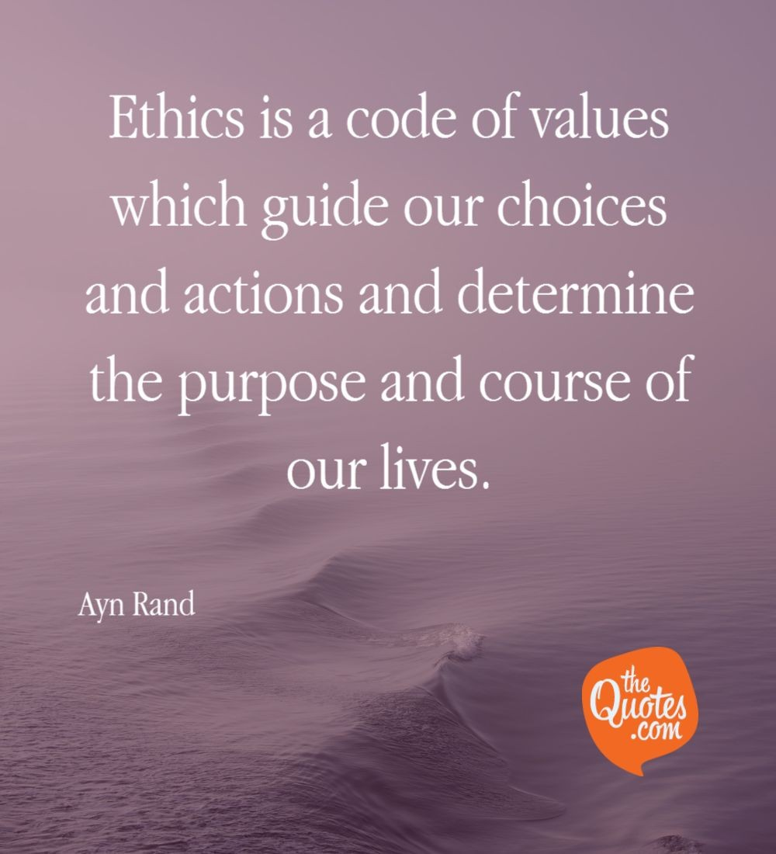

Slide 3
Applied Ethics & Ethical Reasoning

Slide 4
Definition of Ethics
“Ethics is a branch of philosophy; it is moral philosophy or philosophical thinking about morality, moral problems and moral judgments.”

Slide 5
Philosophy
Philosophy is a set of views or beliefs about life and the universe.
Philosophy is a process of reflecting on and criticizing our most deeply held conceptions and beliefs.
Philosophy is a rational attempt to look at the universe as a whole.
Philosophy is the logical analysis of language and the clarification of the meaning of words and concepts.

Slide 6
Moral philosophy
Moral philosophy is the philosophical thinking about moral terms, moral principles, moral judgments, moral language, what is morally good and bad, right and wrong.

Slide 7
Another Definition of Ethics
“We may define ethics as the normative science of the conduct of human beings living in societies-a science which judges this conduct to be right or wrong, to be good or bad, or in some similar way.”

Slide 8
Types of Ethics
The word "ethics" is derived from the Greek "ethos" (meaning "custom" or "habit").
Ethics differs from morals and morality in that sense ethics denotes the theory of right action and the greater good, while morals indicate their practice.

Slide 9
There are four types of ethics:
Normative ethics
Descriptive ethics
Metaethics
Applied ethics

Slide 10
Normative ethics
Normative Ethics (or Prescriptive Ethics) is the branch of ethics concerned with establishing how things should or ought to be, how to value them, which things are good or bad, and which actions are right or wrong. It attempts to develop a set of rules governing human conduct, or a set of norms for action.

Slide 11
Three main categories of normative ethics are:
Utilitarianism or Consequentialism: Consequentialism argues that the morality of an action is contingent on the action's outcome or result. Thus, a morally right action is one that produces a good outcome or consequence.

Slide 12
II. Deontology: Deontology is an approach to ethics that focuses on the rightness or wrongness of actions themselves, as opposed to the rightness or wrongness of the consequences of those actions. It argues that decisions should be made considering the factors of one's duties and other's rights (the Greek 'deon' means 'obligation' or 'duty').

Slide 13
III. Virtue ethics: virtue ethics focuses on the inherent character of a person rather than on the nature or consequences of specific actions performed.

Slide 14
Descriptive Ethics
Descriptive Ethics is a value-free approach to ethics which examines ethics from the perspective of observations of actual choices made by moral agents in practice. It is mainly historical or anthropological.

Slide 15
Metaethics
Meta-Ethics is concerned primarily with the meaning of ethical judgements, and seeks to understand the nature of ethical properties, statements, attitudes, and judgements and how they may be supported or defended.

Slide 16
Applied ethics
Applied Ethics is a discipline of philosophy that attempts to apply ethical theory to real-life situations. It is used in determining public policy. E.g.“ Do animals have rights as well?"

Slide 17
Applied Ethics
Applied ethics is a branch of ethics devoted to the treatment of moral problems, practices, and policies in personal life, professions, technology, and government.

Slide 18
In contrast to traditional ethical theory—concerned with purely theoretical problems such as, for example, the development of a general criterion of rightness—applied ethics takes its point of departure in practical normative challenges.

Slide 19
Branches of applied ethics
Subsets of applied ethics include medical ethics, bioethics, business ethics, legal ethics, moral reasoning and personhood, professional ethics, social ethics, distributive justice, environmental ethics, and others.

Slide 20
Example of Ethical Reasoning
Suppose that all your life you have been trying to be a good person, doing your duty as you see it and seeking to do what is for the good of your fellowmen. Suppose, also, that many of your fellowmen dislike you and what you are doing and even regard you as a danger to society, although they cannot really this to be true.

Slide 21
Suppose, further, that you are indicated, tried, and condemned to death by a jury of your peers, all in a manner which you correctly consider to be quite unjust. Suppose, finally, that while you are prison awaiting execution, your friends arrange an opportunity for you to escape and go into exile with your family. They argue that

Slide 22
they can afford the necessary bribes and will not be endangered by your escaping; that if you escape, you will enjoy a longer life; that your wife and children will be better off; that your friends will still be able to see you; and that people generally will think that you should escape. Should you take the opportunity?

Slide 23
To answer this question:
Firstly, we must not let our decision be determined by our emotions, but must examine the question and follow the best reasoning. We must try to get our facts straight and to keep our minds clear. Questions like this can and should be settled by reason.

Slide 24
Secondly, we cannot answer such questions by appealing to what people generally think. They may be wrong. We must try to find an answer we ourselves can regard as correct. We must think for ourselves.

Slide 25
Finally, we ought never to do what is morally wrong. The only question we need to answer is whether what is proposed is right or wrong, not what will happen to us, what people will think of us, or how we feel about what has happened.

Slide 26
There is a threefold argument that we ought not to take the opportunity of escaping:
We should not harm anyone. One’s escaping would harm the state, since it would violate and show disregard for the state’s laws.

Slide 27
2. If one remains living in a state when one could leave it, one morally agrees to obey its laws. If we were to escape we would be breaking an agreement, which is something one should not do.
3. One’s society or state is virtually one’s guardian, and one ought to obey one’s guardian or authority.

Slide 28
Moral Law
From, these arguments we can appeal to some moral laws:
That we ought never to harm anyone.
That we ought to keep our promises, and
That we ought to obey or respect our guardians or authority.

Slide 29
Some thought experiements
What is ethics?
What are the different type of ethics?
What is moral reasoning?
What is moral philosophy?

Slide 30
Ethical Problem Analysis
Ethical Problem Analysis
ROBOETHICS
https://interestingengineering.com/roboethics-the-human-ethics-applied-to-robots#:~:text=A%20robot%20may%20not%20injure,conflict%20with%20the%20First%20Law

Slide 31
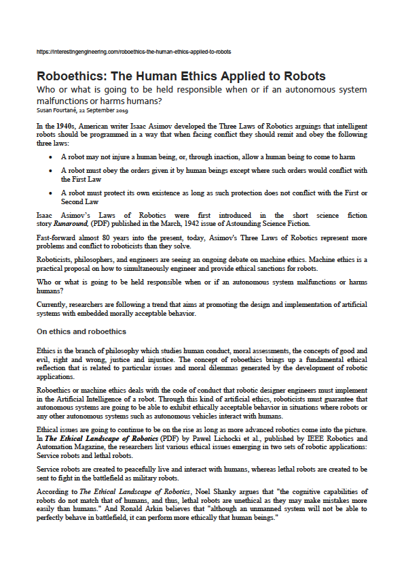


Slide 32
Roboethics: The Human Ethics Applied to Robots
Who or what is going to be held responsible when or if an autonomous system malfunctions or harms humans?
Susan Fourtané, 22 September 2019
In the 1940s, American writer Isaac Asimov developed the Three Laws of Robotics arguings that intelligent robots should be programmed in a way that when facing conflict they should remit and obey the following three laws:
• A robot may not injure a human being, or, through inaction, allow a human being to come to harm
• A robot must obey the orders given it by human beings except where such orders would conflict with the First Law
• A robot must protect its own existence as long as such protection does not conflict with the First or Second Law
Isaac Asimov’s Laws of Robotics were first introduced in the short science fiction story Runaround, (PDF) published in the March, 1942 issue of Astounding Science Fiction.
Fast-forward almost 80 years into the present, today, Asimov's Three Laws of Robotics represent more problems and conflict to roboticists than they solve.
Roboticists, philosophers, and engineers are seeing an ongoing debate on machine ethics. Machine ethics is a practical proposal on how to simultaneously engineer and provide ethical sanctions for robots.
Who or what is going to be held responsible when or if an autonomous system malfunctions or harms humans?
Currently, researchers are following a trend that aims at promoting the design and implementation of artificial systems with embedded morally acceptable behavior.

Slide 33
On ethics and roboethics
Ethics is the branch of philosophy which studies human conduct, moral assessments, the concepts of good and evil, right and wrong, justice and injustice. The concept of roboethics brings up a fundamental ethical reflection that is related to particular issues and moral dilemmas generated by the development of robotic applications.
Roboethics or machine ethics deals with the code of conduct that robotic designer engineers must implement in the Artificial Intelligence of a robot. Through this kind of artificial ethics, roboticists must guarantee that autonomous systems are going to be able to exhibit ethically acceptable behavior in situations where robots or any other autonomous systems such as autonomous vehicles interact with humans.
Ethical issues are going to continue to be on the rise as long as more advanced robotics come into the picture. In The Ethical Landscape of Robotics (PDF) by Pawel Lichocki et al., published by IEEE Robotics and Automation Magazine, the researchers list various ethical issues emerging in two sets of robotic applications: Service robots and lethal robots.
Service robots are created to peacefully live and interact with humans, whereas lethal robots are created to be sent to fight in the battlefield as military robots.
According to The Ethical Landscape of Robotics, Noel Shanky argues that "the cognitive capabilities of robots do not match that of humans, and thus, lethal robots are unethical as they may make mistakes more easily than humans." And Ronald Arkin believes that "although an unmanned system will not be able to perfectly behave in battlefield, it can perform more ethically that human beings."

Slide 34
Robots in the military: Designed to kill and moral accountability
Military robots are certainly not just a thing of the present. They date back to World War II and the Cold War. The German Goliath tracked mines and the Soviet teletanks. Military robots can be used to fire a gun, disarm bombs, carry wounded soldiers, detect mines, fire missiles, fly, and so on.
Today, many other uses for military robots are being developed applying other technologies to robotics. The U.S. military is going to count with a fifth of its combat units fully automated by 2020.
What kind of roboethics are going to be embedded to military robots and who is going to decide upon them? Asimov's laws cannot be applied to robots that are designed to kill humans.
Also in 2020, the U.S. army is going to live test armored robotic vehicles. A demonstration was held in May in Texas.
Will robots become moral agents in the future?
Roboethics will become increasingly important as we enter an era where more advanced and sophisticated robots as well as Artificial General Intelligence (AGI) are going to become an integral part of our daily life.
Therefore, the debate in ethical and social issues in advanced robotics must become increasingly important. The current growth of robotics and the rapid developments in Artificial Intelligence require roboticists and humans in general to be prepared sooner rather than later.
As the discussion in roboethics advances, some argue that robots will contribute to building a better world. Some others argue that robots are incapable of being moral agents and should not be designed with embedded moral-decision making capabilities.
Finally, perhaps not yet but in the future robots could become moral agents with attributed moral responsibility. Until then, engineers and designers of robots must assume responsibility regarding the ethical consequences of their creations.
In other words, engineers and designers of robots must be morally accountable for what they design and bring out into the world.

Slide 35
Ethical Problem Analysis
Conceptual Background
Ethical Analysis
Policy Issues
Solution of a Question

Slide 36
Thanks
Thank You!!!

